Slide 1
The Design of a Virtual Reality Game for STEM Education
Tyler Gantz

Slide 2
Introduction
Innovative learning tools for students
Game-based learning
Virtual Reality

Slide 3
Objective
Use the immersive capabilities of VR to create a fun and educational learning tool for electrical engineering students

Slide 4
Design Requirements
Utilize key features of VR, such as motion tracking and in-game object interaction
Cover 3 subjects in the Electrical Engineering field
DC Circuits, AC Circuits, Digital Circuits
Include both educational and recreational elements

Slide 5
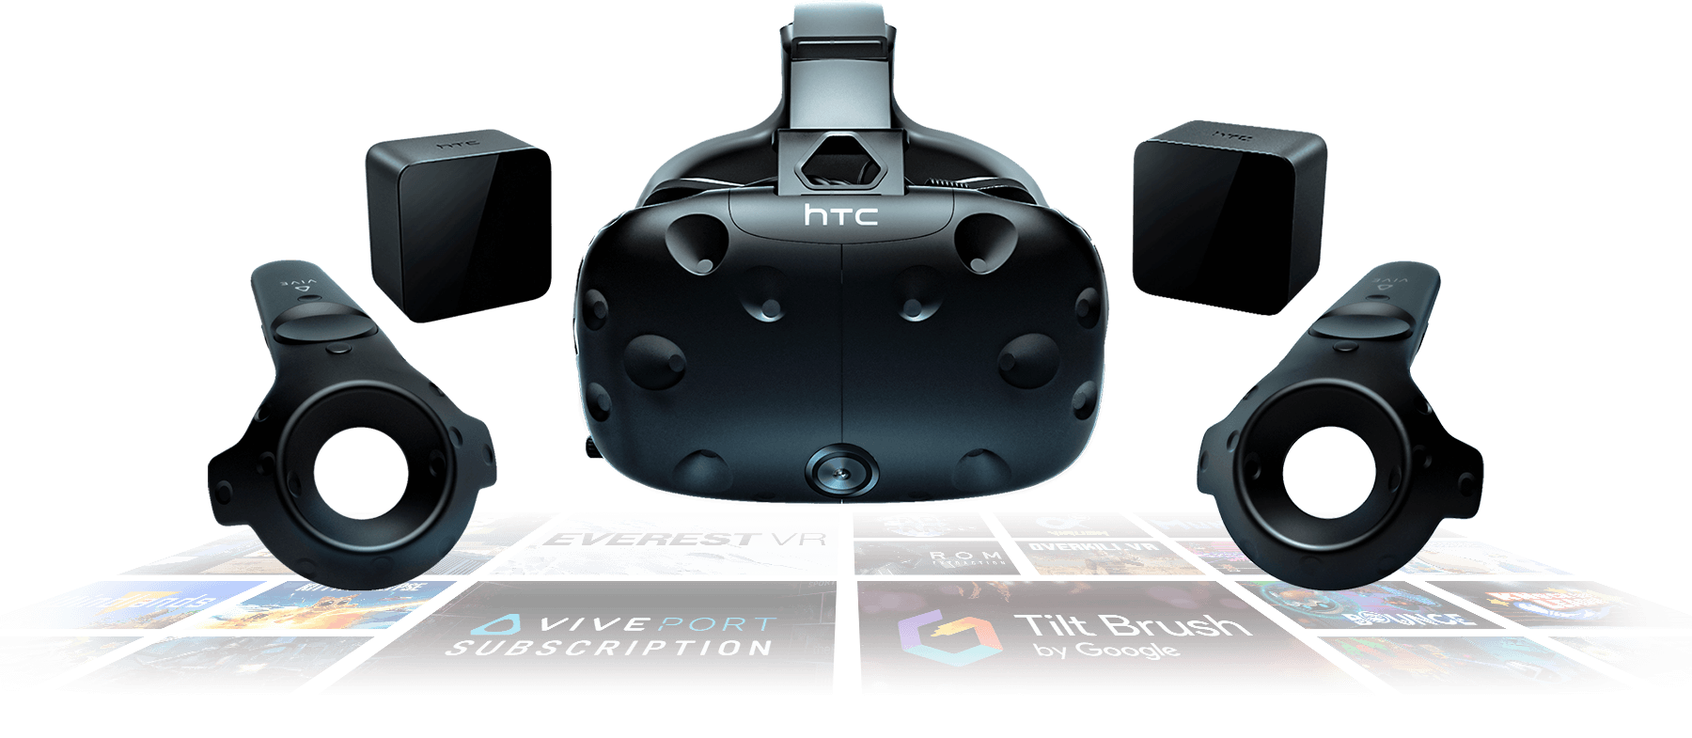
Design Constraints
Designed for the HTC Vive
Playable within the minimum space requirements listed by HTC

Slide 6
Design Method

Slide 7
Implementation Plan
Task 1: Engine configuration
Subtask 1. Unity vs Unreal Engine
Research for each engine and decide which one will be best suited
Subtask 2. Chose Unity – Configure for development
Study and complete tutorials provided with the software
Complete internet and textbook guides
Setup the Vive for use in the engine
Write some scripts that can be used in the game
Task 2. Lay out a plan for the game
Used the preparation time to figure out what can be achieved in the Unity engine, and to brainstorm topics for the game
Define a setting
Define objectives

Slide 8
Implementation Plan (continued)
Task 3. Development
Subtask 1. Acquire necessary components to build the game
Asset packs for objects, environment design, special effects, etc.
Ongoing throughout development
Subtask 2. Developing DC Circuit Challenge
Scene development
Subtask 3. Develop key features
Moving skybox
LCD Screens
Guns and shooting system
Subtask 3. Developing AC Circuit Challenge
Scene development
Coding
Subtask 4. Developing Digital Circuit Challenge
Scene development
Coding

Slide 9


Task 1: Engine Configuration
Task 1: Unity vs. Unreal Engine
Both capable of creating great games, but present different details and challenges
Unreal Engine
More powerful engine – allows for more stunning visuals
Only recently became free to use, less documentation available
Utilizes C++ for programming
Unity
Possesses a learning curve, but much more user friendly for beginners
Vast amount of documentation available publicly online
Utilizes C# for programming

Slide 10
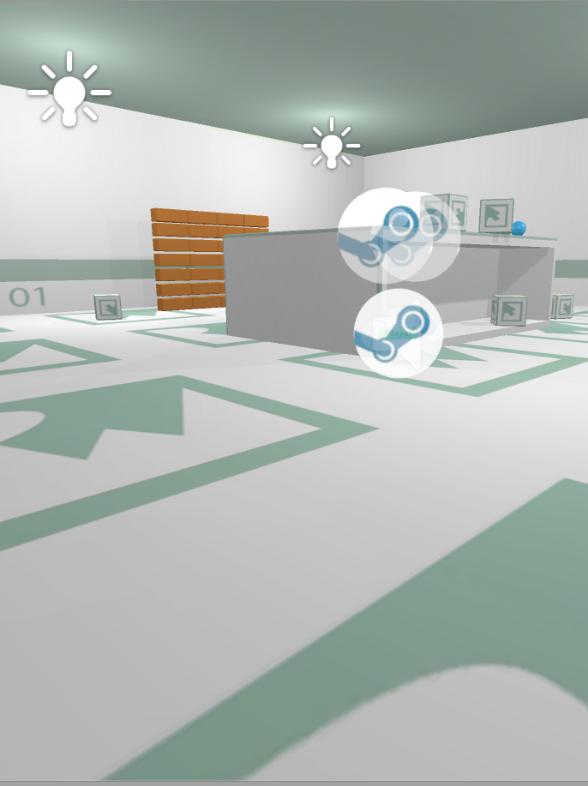
Task 1: Engine Configuration
Subtask 2. Chose Unity – Configure the engine for development
Completed tutorials on scene building
Different object types
Transforming objects (position, rotation, scale)
Found a small, simple scene online to use to test scripts and the SteamVR plugin
SteamVR player prefab
Making objects interactable - pick up and throw
Teleporting

Slide 11
Task 2: Laying out a plan for the game
Over the course of configuration, themes and objectives were brainstormed for the game.
Setting: Futuristic, sci-fi, alien spaceship
Main Objective: Escape the ship
Educational Objectives
Multiple Choice questions
Circuit Design
Recreational Objectives
Shooting enemies, targets, etc.
Time-limited puzzles
Combine the two objective types to create an escape room-like challenge

Slide 12
Gameplay Flow Diagram
Main Menu
(Pick a Room)
DC Circuit Challenge
Digital Circuit Challenge
AC Circuit Challenge
Examine the room
Multiple Choice Question 1
Objective 1
Multiple Choice Question 2
Objective 2
Multiple Choice Question 3
Objective 3
Success
Circuit Design 2
Objective 5
Multiple Choice Question 5
Objective 4
Multiple Choice Question 4
Circuit Design 1
Failure to complete any step correctly results in a restart for the player

Slide 13

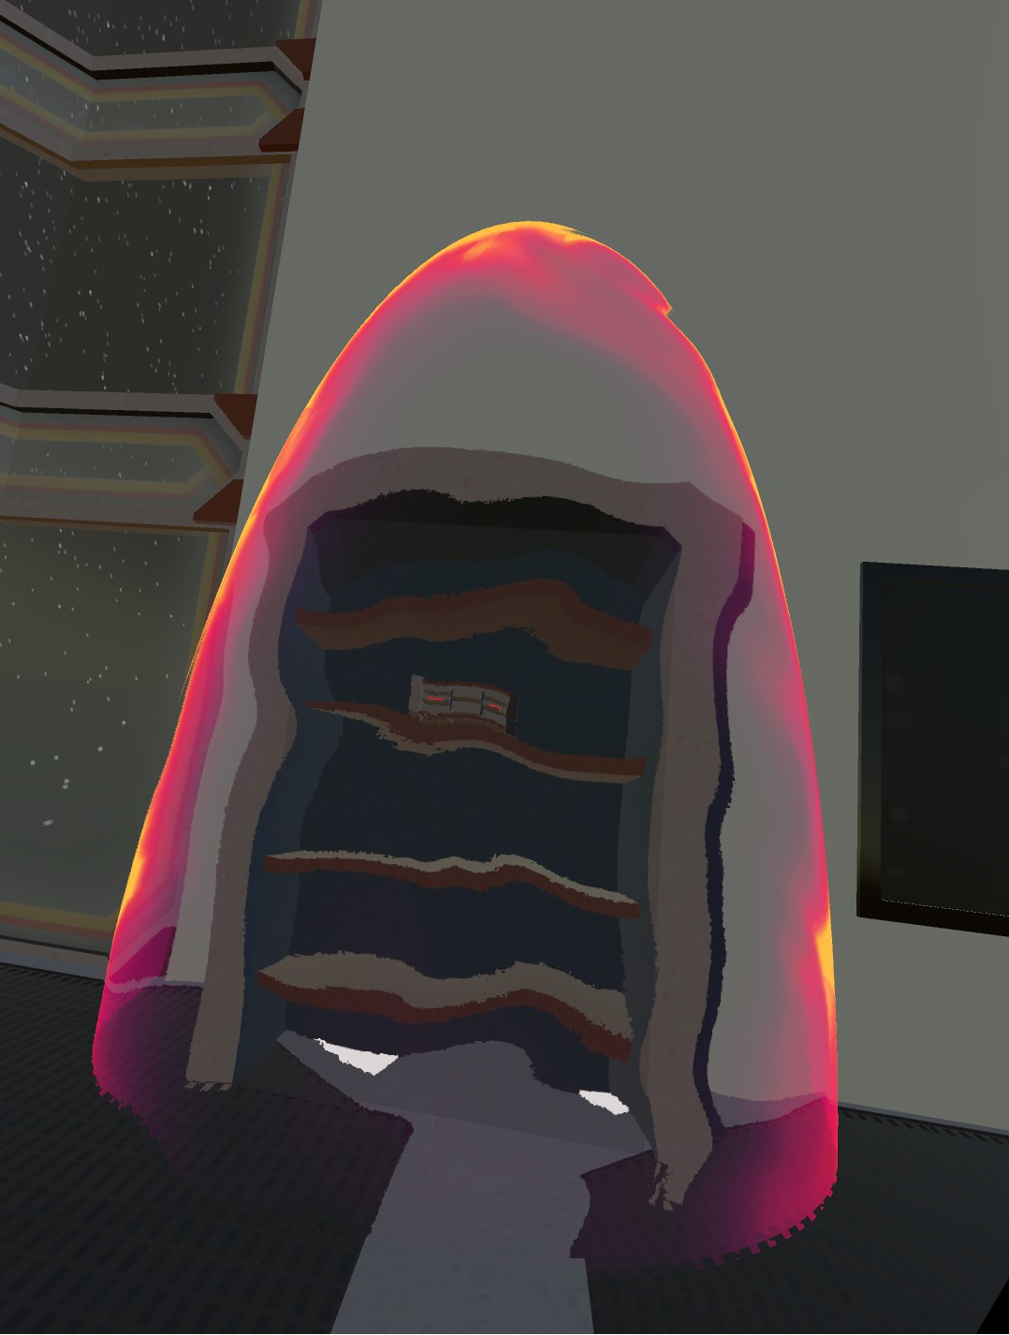
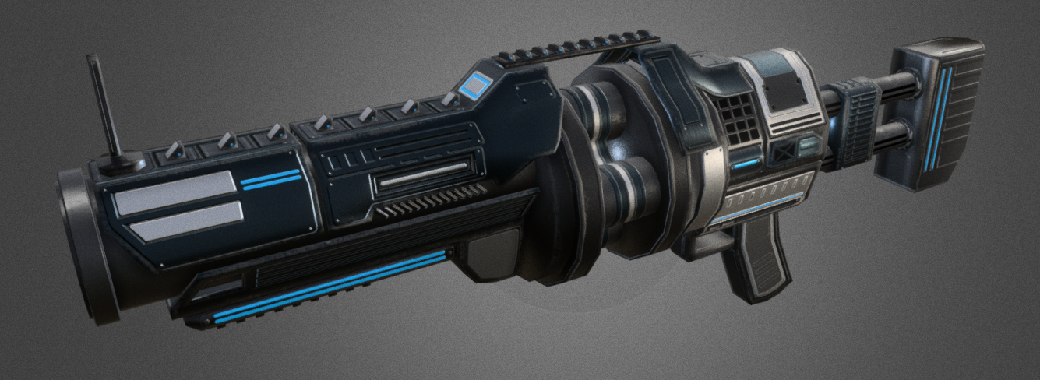
Task 3: Development
Subtask 1. Acquire necessary components to build the game
Unity Asset Store
Asset packs acquired for the project:
Vast Outer Space Skybox
Sci-fi Styled Modular Pack
Force Field Effects
Futuristic Weapon Pack
CRT LCD Shader

Slide 14
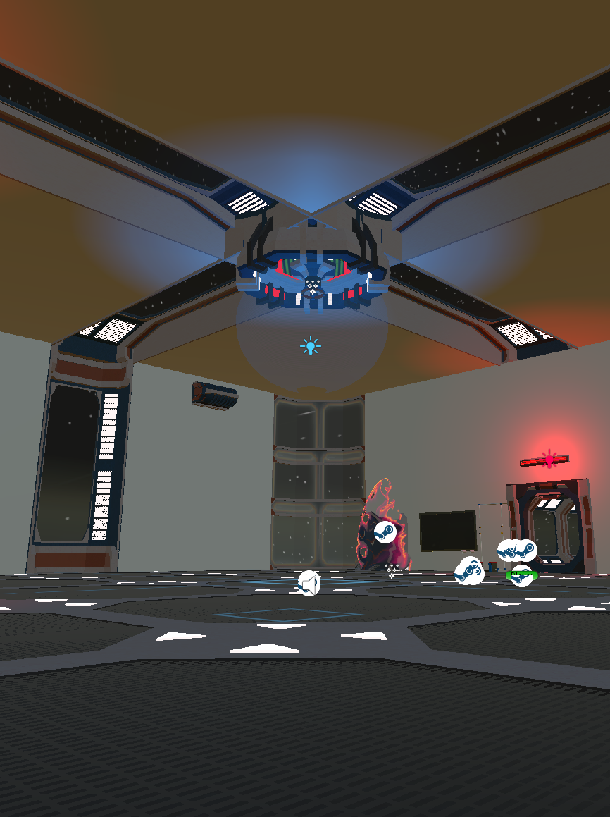
Task 3: Development (continued)
Subtask 2. Develop the scene for the DC Circuit Challenge
Each challenge room will have its own look and set of objectives
Sci-Fi Styled Modular Pack
Early development testing space for key features

Slide 15
Task 3: Development (Continued)
Subtask 3. Develop key features
Script: Rotating skybox
Simply creates a slow, constant rotation to the outer space skybox
Provides a sensation of moving throughout space to the player
Script: Video plays when LCD Screen is touched
Attached the script to the screen
Attaches a video player to the screen, loaded with the desired video clip
Screen set as a trigger, waits for an object with the tag “Player” to contact it
Once the trigger entered, the video starts
Will be used for the multiple choice questions throughout the game
Script: Shootable gun
Placed an invisible game object at the end of the barrel of the gun called “Bullet Spawn”
Selected a suitable bullet game object to be used as a projectile
Attached script specifically to the trigger of the gun
Requires the player to be holding the gun near the trigger in order to be able to shoot it
Used nested “if” statements to check if the player is holding the gun in the correct position, and to check if the trigger on the Vive controller is being pulled
If both conditions are met, the projectile spawns at the bullet spawn object, and shoots forward at a set velocity

